Slide 1
NEED FINDING

Slide 2
Hotel Management- Lotus View

Slide 3
Empathy Map
There are 3 different empathy map we have used.
Customer Empathy Map
Manager Empathy Map
Staff Empathy Map

Slide 4
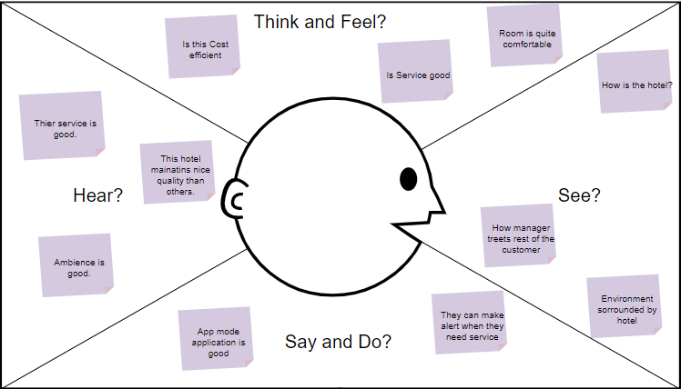
Customer Empathy

Slide 5
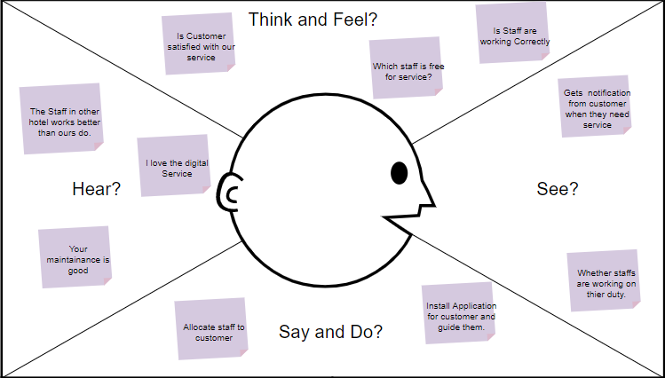
Manager Empathy

Slide 6
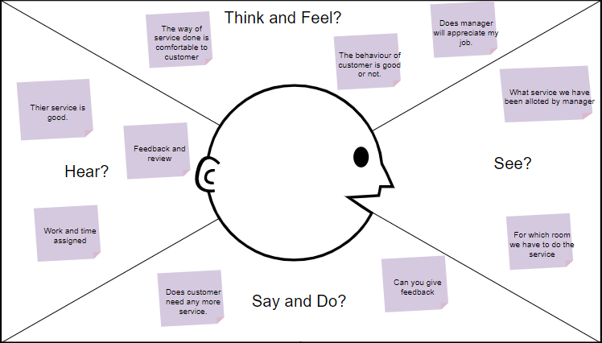
Staff Empathy

